Slide 1
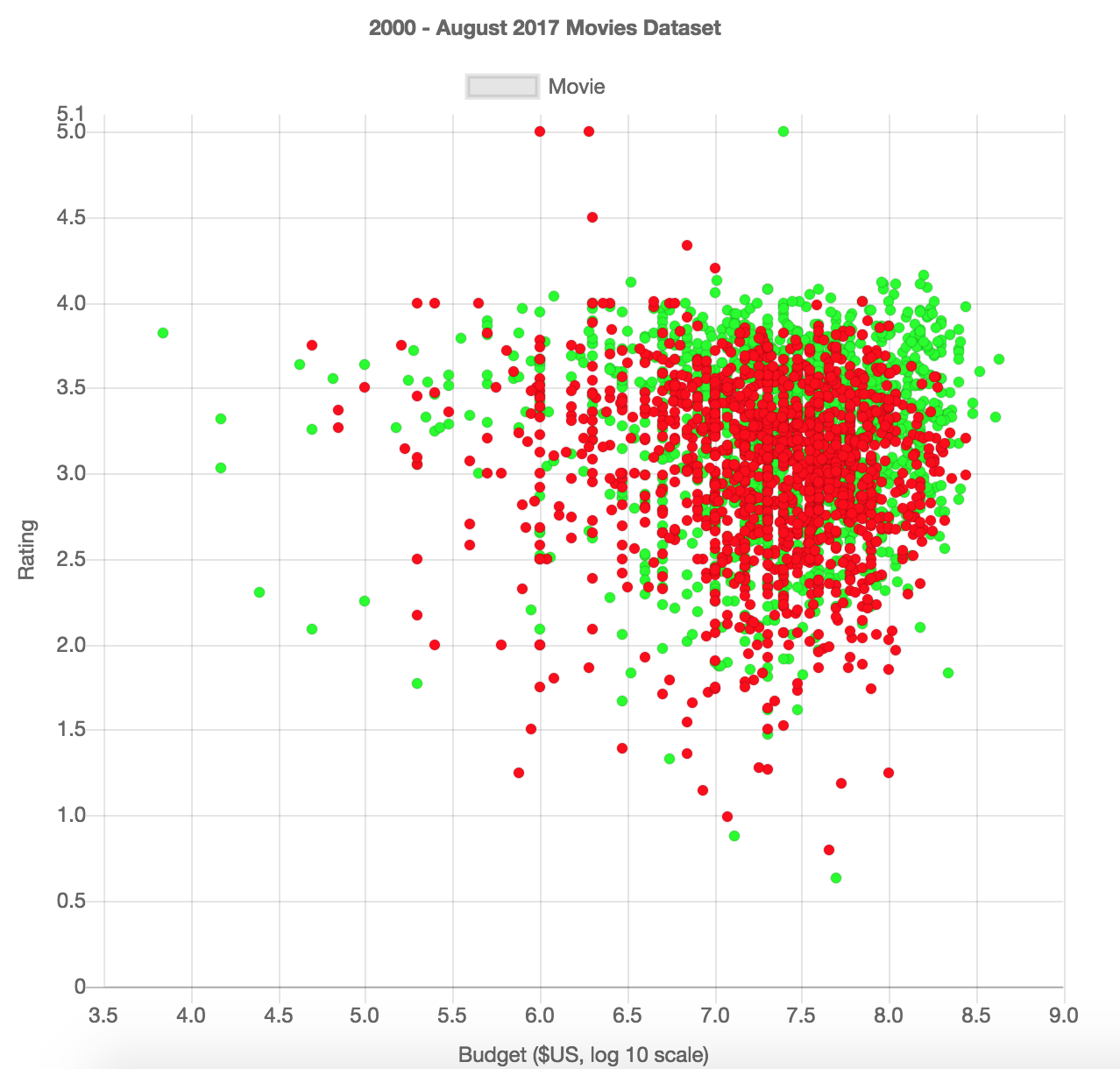
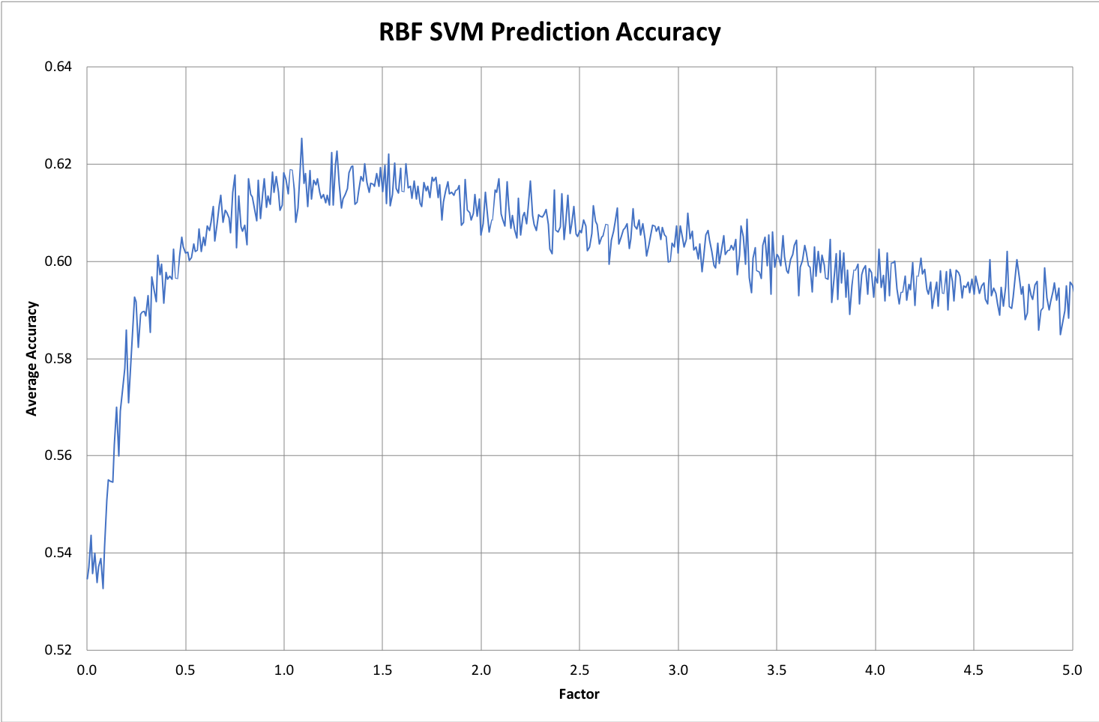
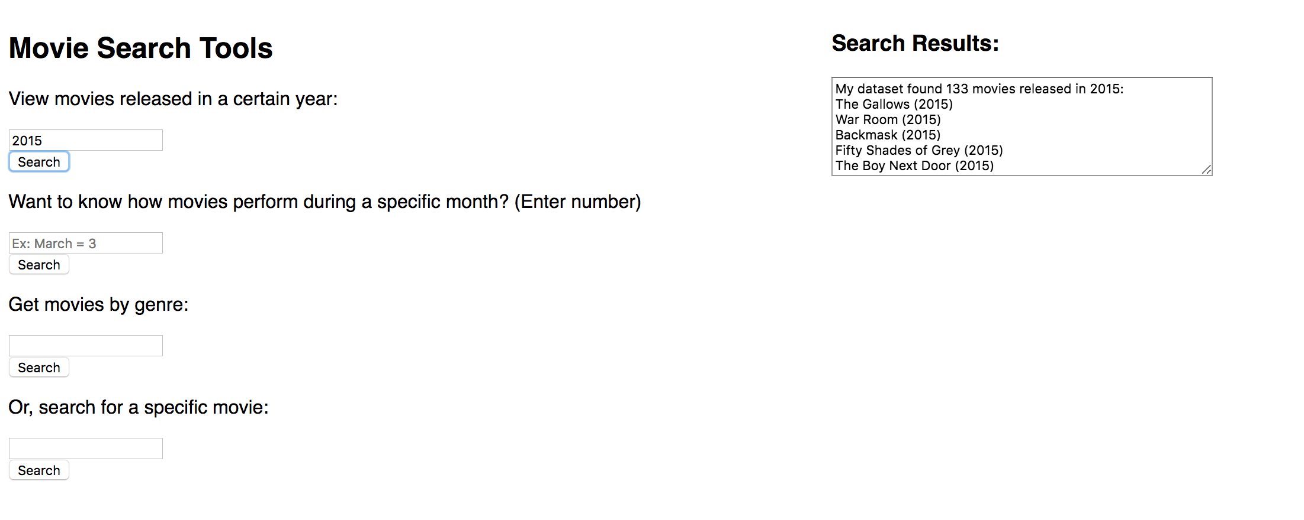
Predicting the Financial Success of Movies
Jeffrey Wang
Mobile and Web Application Development Lab
Thomas Jefferson High School for Science and Technology
Introduction
Development
Results/Conclusion
As someone who follows box office news, I figure that sentiment analysis can be applied to predict the popularity of movies. The total box office gross is a useful measure of a movie’s popularity, and I want to see if audience reception towards a movie affects how much money it will make. With this in mind, I wrote a Python program that used machine learning tools in an attempt to see if user feedback in the form of ratings can predict whether a movie will make a profit. I also built a website that displayed a graphical overview of my movie dataset with search and filter functions.
The first major step is to build the movie dataset. I downloaded the MovieLens dataset, which contains information on ratings for a large list of movies. The MovieLens dataset provides an ID number for each movie so I can easily match a rating to a title.
A table of budgets and worldwide grosses for around 5000 movies is provided by the-numbers website. In order to scrape information from this table, I use the BeautifulSoup library. I read in the URL of the webpage and loop over all instances of the <td> tag. This tag contains information about each row in the table, which will be stored in an array.
The second major step is to use scikit-learn for machine learning. After choosing a classifier, I randomly choose about 80% of my dataset for training, using the fit function. The remaining 20% of my dataset is used for predicting whether a movie is a success or flop. To get a good idea of the accuracy of prediction, I repeat this process over a large amount of iterations.
After selecting the best classifier to use for prediction, I obtained an average accuracy of 62%. I attempted to scale the data points by various factors to determine where I could maximize the prediction accuracy. The best accuracy is obtained with a factor of 1.5x.
Further considerations of this project should include sentiment analysis to gauge how healthy the word of mouth is for a particular movie. This project already included ratings to show how much audiences like a movie, so sentiment analysis can serve as a useful supplement. The sentiment analysis can be performed on social media posts that mention specific movie titles, capturing how audiences react to their viewing of a particular movie.
Background
Machine learning is a subset of artificial intelligence that involves training computer systems to automatically learn without being explicitly programmed. With machine learning, computer systems can learn to identify concepts and relationships hidden in data and use what it learns to make valuable predictions.
Generally, machine learning algorithms can be broken down into three types: supervised learning, unsupervised learning, and reinforcement learning. For this project, the focus will be on supervised learning. Supervised learning consists of a target output variable that is to be predicted from a given set of input variables.
Figure 1. Website Search and Filter Tools
Figure 2. Average Classifier Accuracy
Figure 3. Graphical Display of Movie Dataset

